Slide 1

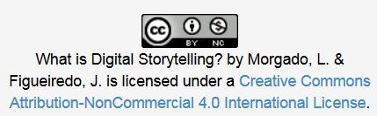
What is Digital Storytelling?
Open Professional Collaboration
for Innovation
Universidade Aberta

Slide 2
What is
DIGITAL
STORYTELLING ?

Slide 3
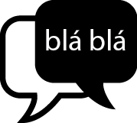



o que é …
ABC
STORYTELLING
MULTIMÉDIA
Traditional art of storytelling
With texto, images, audio or video
DIGITAL
STORYTELLING
www.freepik.com/free-vector/vectors_713852.htm
www.vectoropenstock.com/vectors/preview/70335/multimedia-flat-icons-set

Slide 4
Definition …
“
(…) there are several definitions about Digital Storytelling, but generally, they all revolve around the idea of combining the art of storytelling, with a variety of multimedia resources such as images, audio and video, turning around a chosen topic and often with a particular view.
(Robin, 2006)
Robin, B. (2006). The educational uses of digital storytelling. In C. Crawford, & e. al (Ed.), Proceedings of Society for Information Technology and Teacher Education International Conference (pp. 709-716). Chesapeake, VA: AACE.

Slide 5
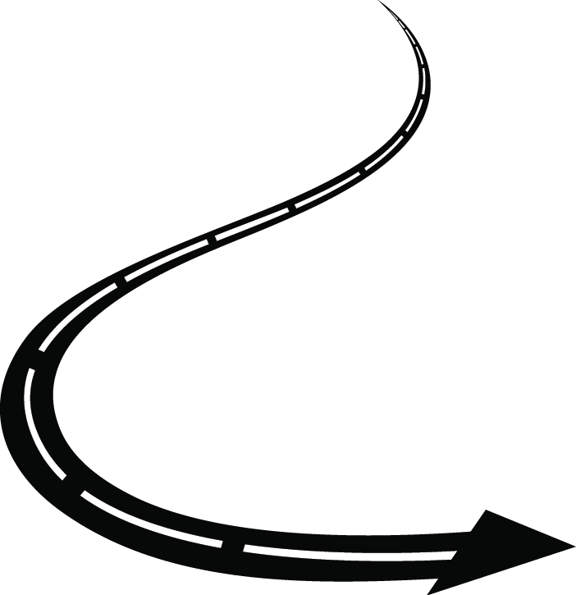
The structure of narratives …
… all stories have a beginning, middle and end.
www.freepik.com/free-vector/vectors_797861.htm

Slide 6
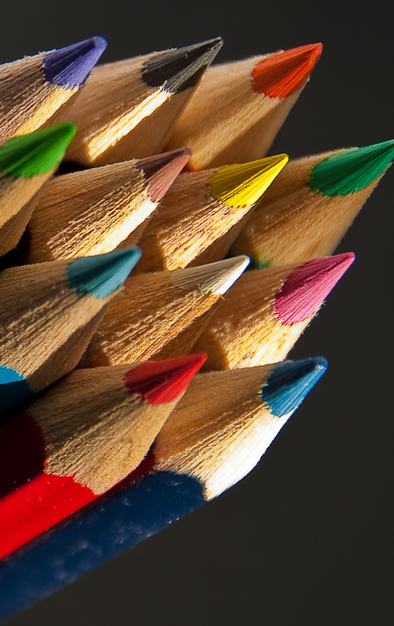
The structure of narratives …
… situation (first)
The character is presented and exposed where and when the story takes place.
Sets up the mood
www.flickr.com/photos/nikonvscanon/3267139809

Slide 7
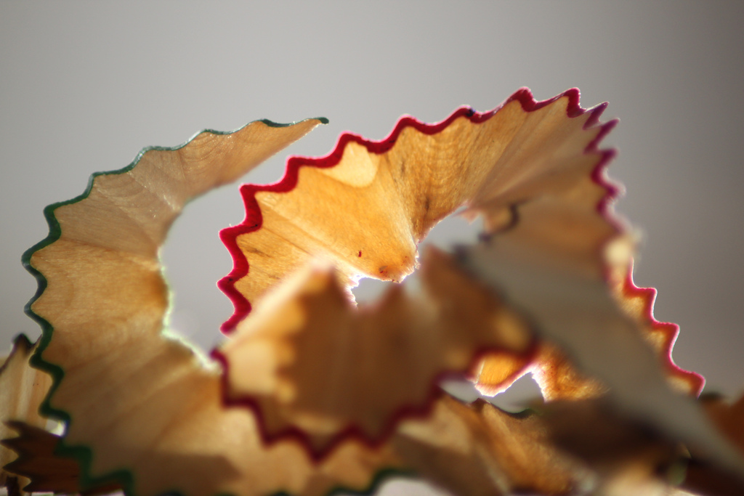
the structure of narratives …
…complication (middle)
It presents the conflict and unfold the various obstacles that the character has to overcome to solve their conflict, to the climax.
www.flickr.com/photos/doyland/5170660795

Slide 8
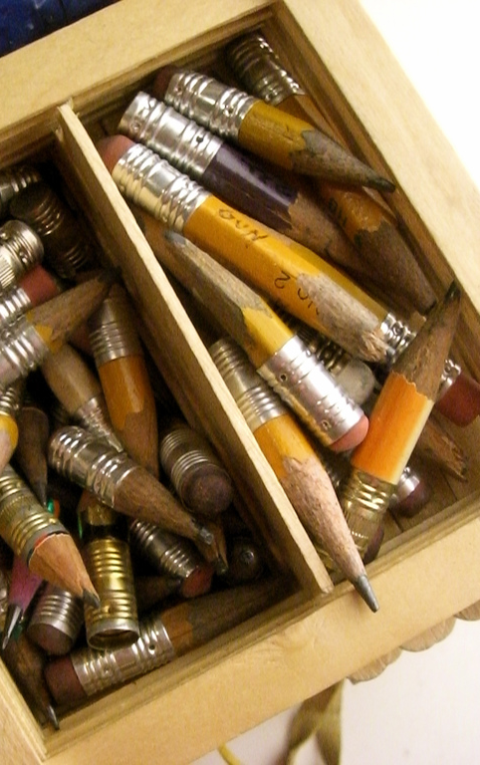
the structure of narratives …
… resolution (end)
When it resolves the conflict and leads the narrative to the end, demonstrated the changes that (s) character suffered throughout their journey.
www.flickr.com/photos/jasoneppink/386302224

Slide 9
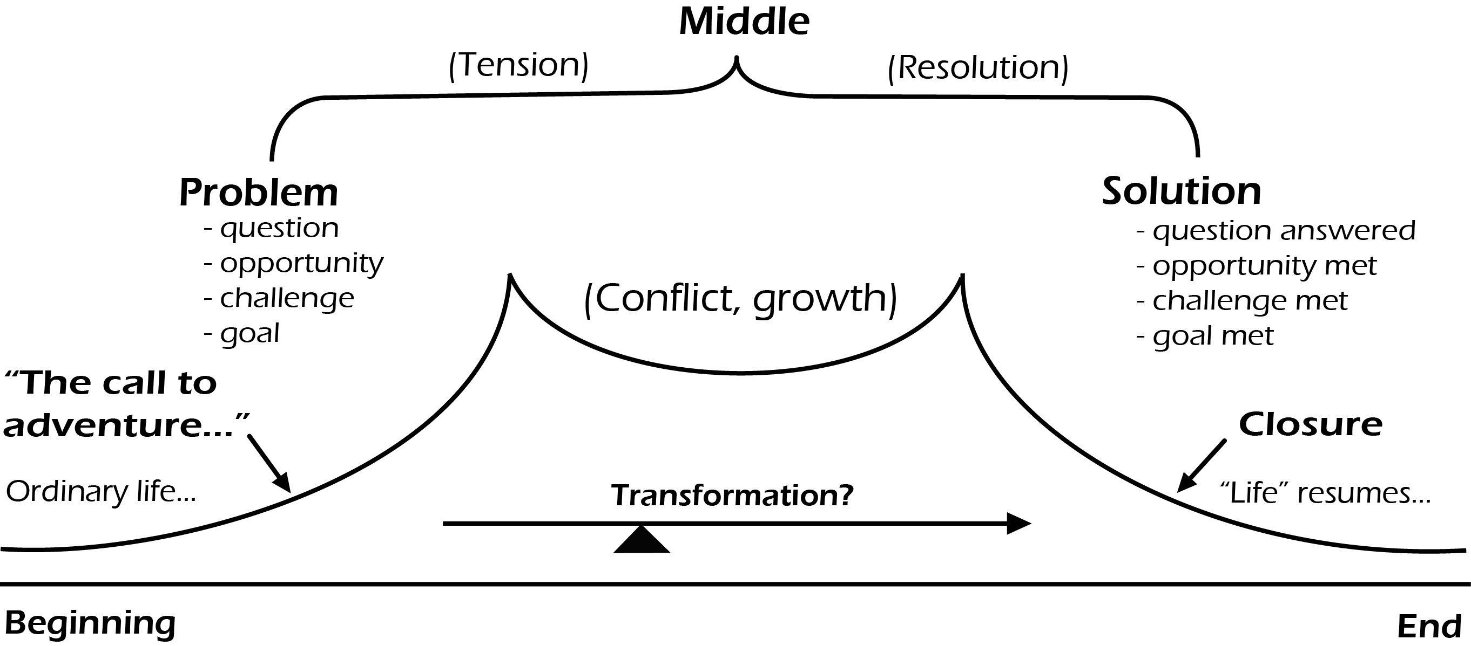
the structure of narratives …
Fig. 1: The structure of narratives, Dillingham, adapted from Ohler
http://hdl.handle.net/10400.2/3472

Slide 10
Produced by Morgado, L. & Figueiredo, J. in the framework of Erasmus+ project
“Open Professional Collaboration for Innovation”
Contributors:
This project has been funded by Erasmus + programme of the European Union. This OER reflects the views only of the authors, and the Commission cannot be held responsible for any use which may be made of the information contained therein.

