Slide 1
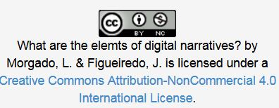
What are the elements of digital narratives?
Open Professional Collaboration
for Innovation
Universidade Aberta

Slide 2
Elements of Digital Storytelling
7 Elements
of
Digital Storytelling
Digital Storytelling
(Lambert, 2013)

Slide 3
Video
One of the starting points for the development of digital storytelling, through the knowledge of the seven elements characteristic of Digital Storytelling, developed and published by the Center for Digital Storytelling (Lambert, 2003; Robin, 2006; Jakes, 2007) and with a certain sequence.

Slide 4
Video
https://www.youtube.com/watch?v=a1f-_FXgJZM

Slide 5
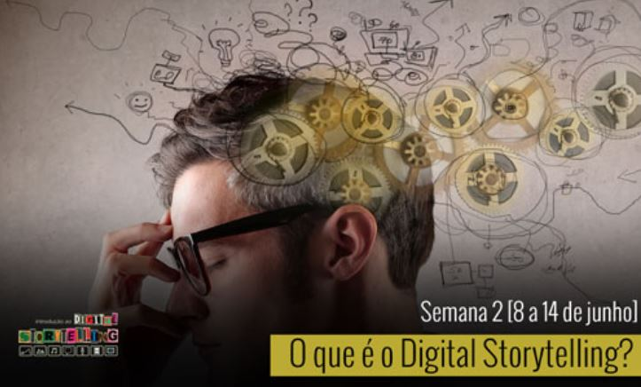
1. Point of View
What is the point of view of the story and what is the author's perspective?
all stories have a certain goal and pass the point of view or perspective of the author. However, this should remain simple, avoiding too much information, that may cause some kind of noise and divert the public's attention to other aspects, away from the initial purpose
Point of View

Slide 6
2. Dramatic Question
The key question that hold the user's attention and will be answered at the end of the story
The narrative should take place around a dramatic initial question, which aims to arouse curiosity and that will be answered by the end.
Your goal is to leave the audience thinking, thus contributing to capture your attention throughout the course of the narrative

Slide 7
3. The Gift of Your Voice
One way to personalize your story to help the audience understand the context
The strategy to use voice to narrate the story, or part of it, is one way to customize the narrative, giving it a more personal and unique nature, contributing to help understanding more complex issues.
It is necessary to take precautions when performing the recording. The public needs time to process all the information (images, sounds, audio, ...), so a more leisurely pace will be necessary for the assimilation of the message

Slide 8
4. The Power of Soundtrack
The music and other sounds that support and embellish the narrative
1) use of music or sounds, help sustain the whole plot of the story
2) must be used rationally and framed and not just as a mere prop
3) the music or background sounds, should be chosen carefully, otherwise it might confuse the message to be transmitted.
4) never mix background audio with built-in letters during the narration.
5) to the decrease in volume, at times when the narration incorporated.

Slide 9
6. Economy
Use enough content to tell the story without overwhelming the user
the narrative should be short and restricted to content to convey the desired message, avoiding excessive detail so as not to overwhelm the audience with too much information
duration: should focus between 3-5 minutes through the use of images, audio and text messages
3) The text should be utilized in voice replacement or as a supplement.

Slide 10
7. Pacing
The pace of the narrative and how progress faster or slower.
The pace set in the narrative, should be adapted to the course of it: it should not be something constant which may cause some monotony.
The pacing should be adapted for instance by making more rapidly for certain scenes involving an action or slower, in cases involving thriller or suspence.

Slide 11
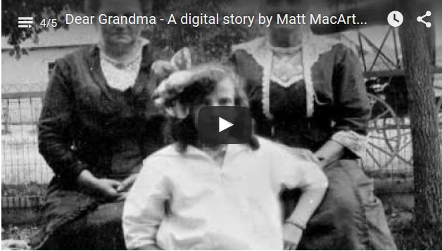
A DST EXAMPLE - Video
https://youtu.be/AAVe4Bob3Ys?list=PLkALXvyBte0GZTE90TLEv_UGRXOCMz-Zm

Slide 12
Produced by Lina Morgado e José Figueiredo in the framework of Erasmus+ project “Open Professional Collaboration for Innovation”
Contributors:
This project has been funded by Erasmus + programme of the European Union. This OER reflects the views only of the authors, and the Commission cannot be held responsible for any use which may be made of the information contained therein.

